Slide 1
Modeling Program State
in SML

Slide 2
Overview
Implement our model of program state m = (env,s) in SML.
Implement a set of functions for interacting with the program state (e.g., accessEnv).
Implement a set of functions for inspecting the program state (e.g., showEnv).

Slide 3
Modeling The program state
in the language SML

Slide 4
Design approach
We will use a top-down approach to designing m.
This means we model (i.e., resolve) m first as a composition of smaller parts.
Initially, the smaller parts will be represented as stubs whose structure will be resolved later.
This approach is closely related to matching.
This design approach is very similar to how one designs a context-free grammar.
This design approach involves thinking at the level of type.

Slide 5
We begin with a matching variable (i.e., a stub) m denoting our program state.

Slide 6
Modeling the Program State (m)
In SML, a tuple is the most direct way to model m.
shape of value = (env,s)
where env and s are matching variables.
So we pin down the type of m as follows.
m = ′a ∗ ′b
where ′a and ′b denote the types of model env and s.
Having resolved m, we need to now decide how to model env and s. That is, we need to resolve these variables in our design.

Slide 7
Modeling the Environment (env)
In SML, a list is the most direct way to model env.
shape of value = [ envElement, … ]
where envElement is a matching variable.
So we pin down the type of env as follows.
env = ′a list
where ′a denotes the type of envElement.
Having resolved env, we need to now decide how to model envElement.

Slide 8
Modeling the Elements of the Environment
In SML, a tuple is the most direct way to model envElement.
shape of value = (id,type,loc)
So we pin down the type of envElement as follows.
envElement = ′a ∗ ′b ∗ ′c
where ′a, ′b and ′c denote the types of id, type, and loc respectively.
We now need to model id, type, and loc.

Slide 9
Modeling Identifiers
In the project language, the set of legal identifiers is very large.
In SML, an identifier should be modeled as a value belonging to a very large set.
We must be able to compare identifiers using equality operators.

Slide 10
Under these conditions and given the subset of SML that we have covered, reasonable choices for modeling the set of identifiers are:
string
int
user-defined datatype
Modeling an id concretely as a string seems a reasonable choice.
id = string
This completes our resolution of id.

Slide 11
Modeling Type
The programming language of the project contains two type values, to which our type checker adds a third value.
We need to model the matching variable type concretely as three distinct values.
Our type checker performs equality comparisons on type values.

Slide 12
In SML, many choices are possible.
Encoding type values as integers (e.g., 0 = error, 1 = bool, 2 = int)
Encoding type values as strings (e.g., “error”, “bool”, “int”)
Encoding type values as values belonging to an enumerated type
The best approach is to model type values as an enumerated type.
This resolves type as follows.
type = types
This completes our resolution of type.
datatype types = INT | BOOL | ERROR;

Slide 13
Modeling loc
Values of type loc represent addresses in memory.
The number of distinct locations we choose to allow/model is implementation dependent.
However, in order to be able to execute programs of reasonable size, the address space should be “fairly large” (e.g., more than 10K addresses).
We must be able to compare locations using equality operators.

Slide 14
In SML, integers are the simplest way to model loc values.
This resolves loc as follows.
loc = int
This completes our resolution of loc.

Slide 15
Examples of Env Values
[]
[ (“x”,INT,0) ]
[ (“x”,INT,1), (“y”,BOOL,0) ]

Slide 16
datatype types = INT | BOOL | ERROR;
val env0 = [];
val env1 = [ (“x”,INT,0) ];
val env2 = [ (“x”,INT,1), (“y”,BOOL,0) ];

Slide 17
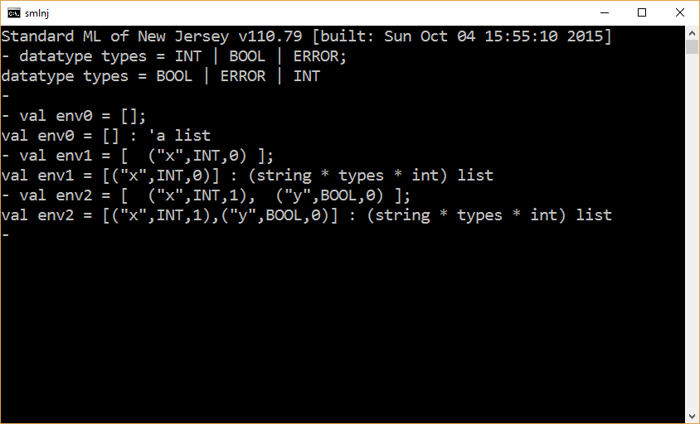

Slide 18
Modeling the Store (s)
In SML, a list is the most direct way to model s.
shape of value = [ sElement, … ]
where sElement is a matching variable.
So we pin down the type of s as follows.
s = ′a list
where ′a denotes the type of sElement.
Having resolved s, we need to now decide how to model sElement.

Slide 19
Modeling the Elements of the Store
In SML, a tuple is the most direct way to model sElement.
shape of value = (loc,denotableValue)
Recall, that we have already have the resolution loc = int.
So we pin down the type of sElement as follows.
sElement = int ∗ ′a
where ′a denotes the type of denotableValue.
We now need to model denotableValue.

Slide 20
Modeling Denotable values
In the project language there are only 2 types of denotable values: Boolean values and integer values.
We need to design a single SML type whose elements can denote these two types of values.
There are 2 direct ways to accomplish this.
Translate Boolean and integer values to strings (e.g., “true”, “27”).
Create a user-defined datatype capable of representing both types of values.

Slide 21
datatype denotable_value = Boolean of bool
| Integer of int;
This resolves denotableValue as follows.
denotableValue = denotable_value
This completes our resolution of denotableValue.

Slide 22
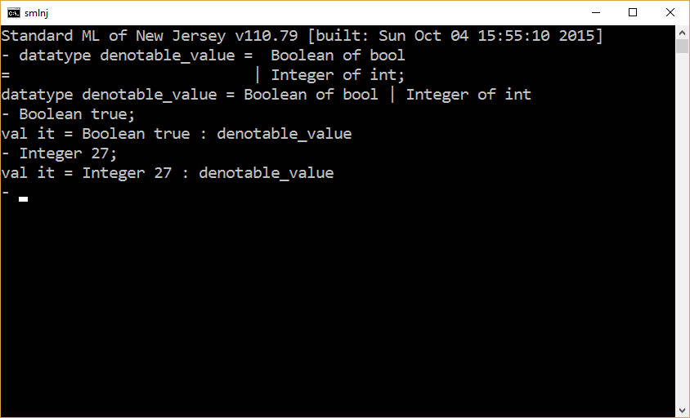

Slide 23
Examples of Program state
datatype types = INT | BOOL | ERROR;
datatype denotable_value = Boolean of bool
| Integer of int;
val m1 = ([],[]);
val m2 = ([(“x”,BOOL,0)],[(0,Boolean true)]);
val m3 = ([(“y”,INT ,0)],[(0,Integer 27 )]);

Slide 24
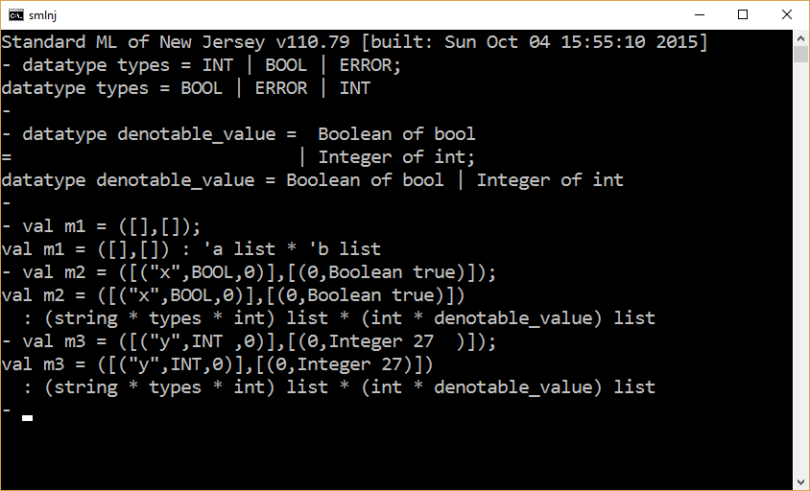

Slide 25
Interacting with the Program state
accessEnv and updateStore

Slide 26
An Exception Infrastructure
exception runtime_error;
fun error msg = ( print msg; raise runtime_error );

Slide 27
accessEnv
fun accessEnv ( id1, (env,s) ) =
let
val msg = “Error: accessEnv ” ^ id1 ^ “ not found.”;
fun aux [] = error msg
| aux ((id,t,loc)::env) =
if id1 = id then (t,loc)
else aux env;
in
aux env
end;

Slide 28
exception runtime_error;
fun error msg = ( print msg; raise runtime_error );
datatype types = INT | BOOL | ERROR;
datatype denotable_value = Boolean of bool
| Integer of int;
fun accessEnv ( id1, (env,s) ) =
let
val msg = “Error: accessEnv ” ^ id1 ^ “ not found.”;
fun aux [] = error msg
| aux ((id,t,loc)::env) =
if id1 = id then (t,loc)
else aux env;
in
aux env
end;
accessEnv ( “x”, ([],[]) );
accessEnv ( “x”, ([(“x”,INT,0)],[]) );

Slide 29
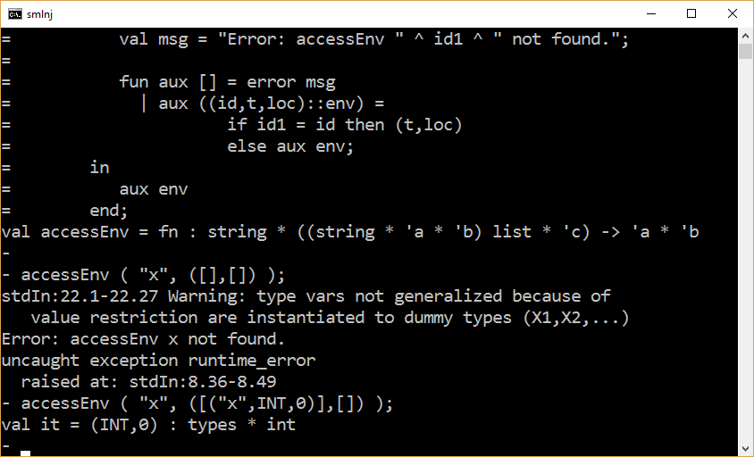

Slide 30
updateStore
The implementation below is functionally correct.
However, you SHOULD NOT implement update store in this manner. Rather, your update function should overwrite the contents of existing memory locations.
That is, whenever possible, the length of the store list should not increase.
fun updateStore ( loc, dv, (env,s) ) =
(env, (loc,dv)::s);

Slide 31
Inspecting the Program state
showEnv

Slide 32
showEnv
fun typeToString BOOL = “bool”
| typeToString INT = “integer”
| typeToString ERROR = “error”;
fun envEntryToString (id,t,loc) =
“(“ ^ id ^ “,” ^ typeToString t ^ “,” ^ Int.toString loc ^ “)”;
fun showEnv [] = print “\n”
| showEnv (entry::env) = (
print(“\n” ^ envEntryToString entry);
showEnv env
);

Slide 33
datatype types = INT | BOOL | ERROR;
fun typeToString BOOL = “bool”
| typeToString INT = “integer”
| typeToString ERROR = “error”;
fun envEntryToString (id,t,loc) =
“(“ ^ id ^ “,” ^ typeToString t ^ “,” ^ Int.toString loc ^ “)”;
fun showEnv [] = print “\n”
| showEnv (entry::env) = (
print(“\n” ^ envEntryToString entry);
showEnv env
);
showEnv [ (“x”, BOOL, 0), (“y”, INT, 27) ];

Slide 34
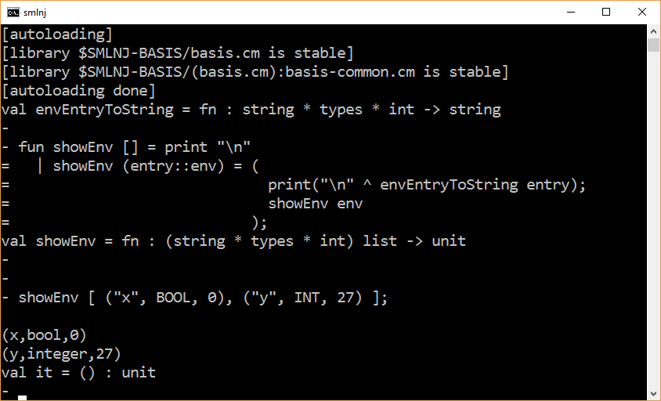

Slide 35
What remains to be done

Slide 36
What remains to be done
Figure out how to implement new().
Idea. The model of the program state could be extended to include a counter. The value of this counter is the next unused location in the store.
m = (env,counter,s)
Implement a complete set of functions for interacting with the program state (e.g., accessEnv, updateEnv, getLoc, getType, accessStore, updateStore).
Recommended. Implement a comprehensive set of functions for inspecting the program state.

Slide 37
The End

